Slide 1
APIs Without A Computer
APIs explained for beginners, Project Managers, and Business Analysts

Slide 2
Introduction

Slide 3
Presenter Information
Kenny Robinson
Programmer Analyst
Working with technology since 2008
Roles include Programmer, Application Support, Testing Automation
@almostengr
rhtservices.net thealmostengineer.com

Slide 4
Objectives
Fundamental knowledge of APIs
Understand vocabulary used by programmers who build and work with APIs
Differences in API formats

Slide 5
Who Is This Course For?
Project managers
Business Analysts
Non-programmer Information Technology (IT) roles

Slide 6
What Is An API?

Slide 7
What Is An API?
Application Programming Interface
Allows for software applications to talk to each other
Android, iPhone, websites can talk to the same system
Technology independent

Slide 8
What Is An API?

Slide 9
What Is An Interface?
A way to interact with a system
Controls in a car

Slide 10
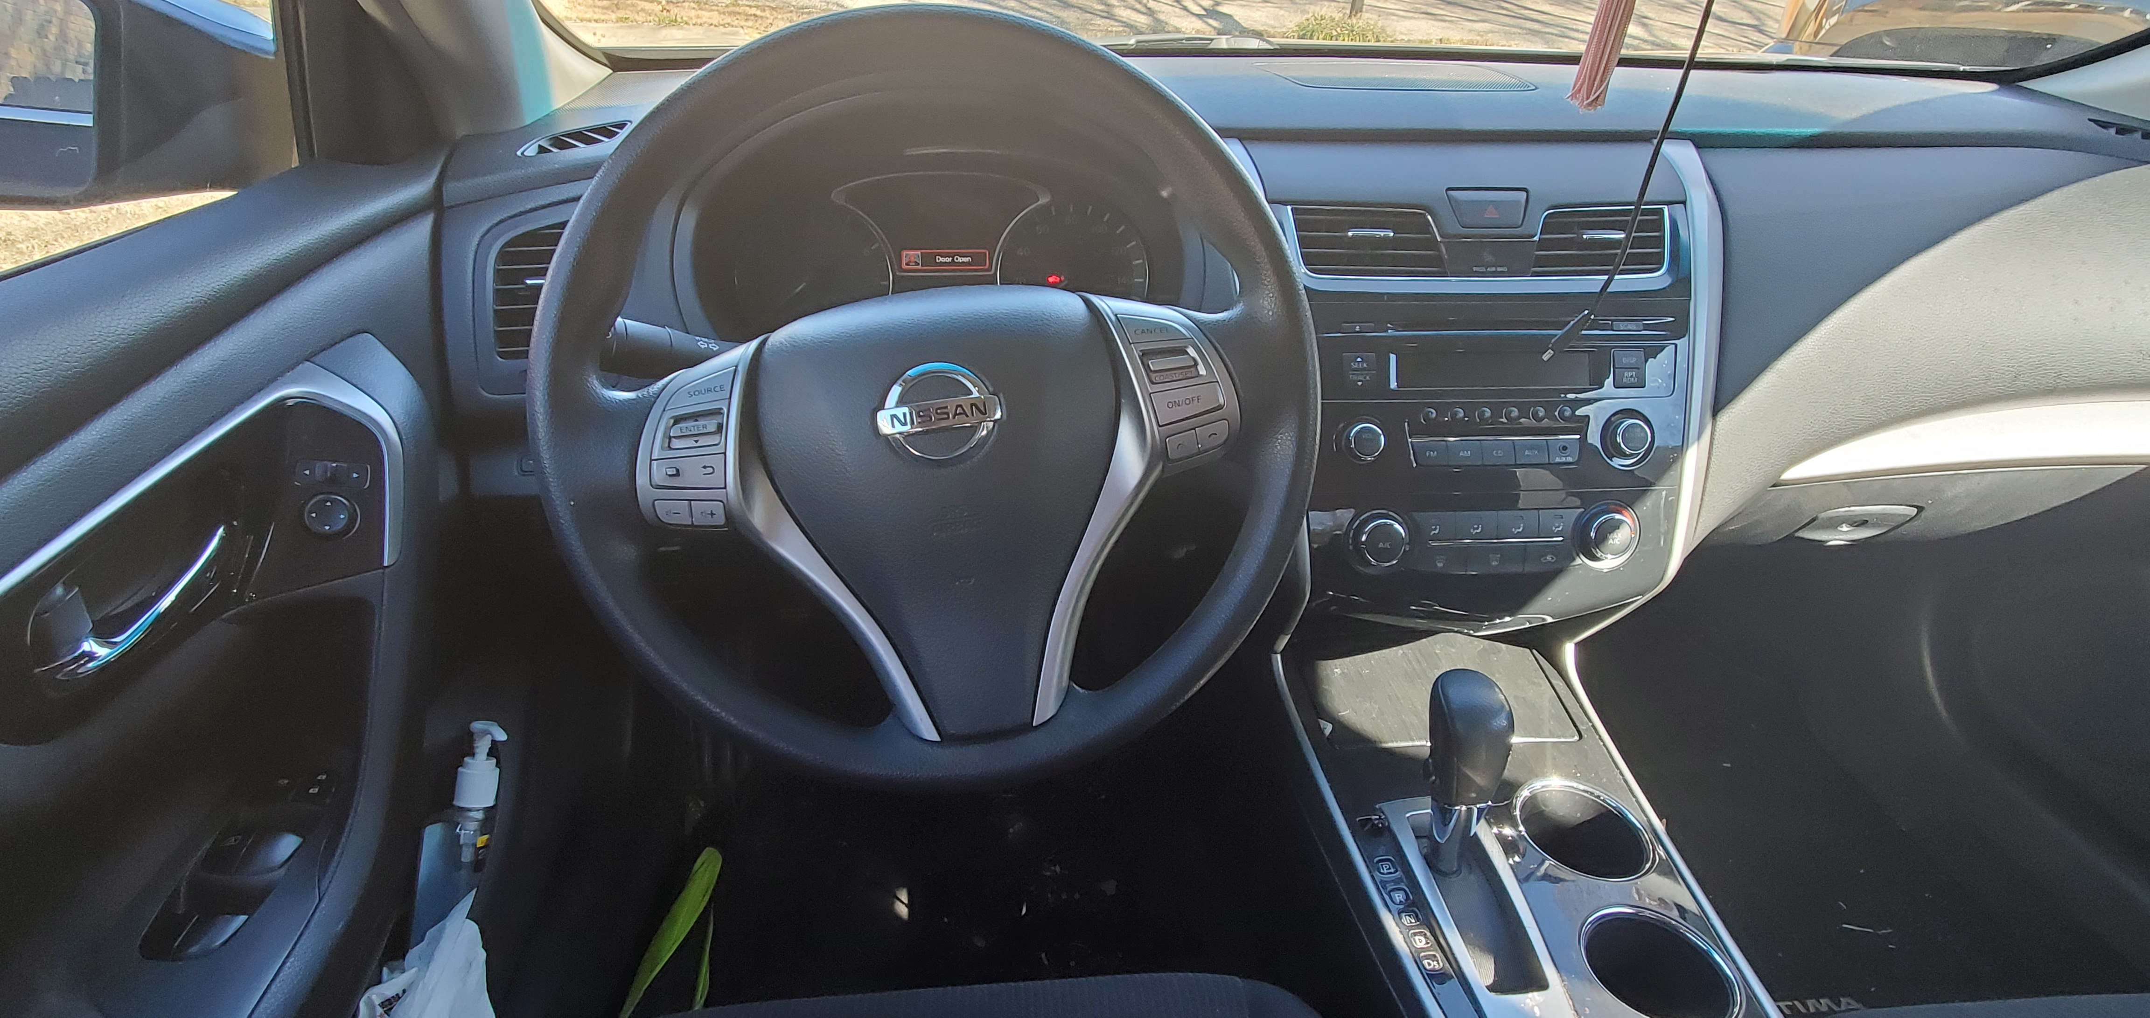
What Is An Interface?

Slide 11
HTTP Request Methods
Many methods exist, only common ones will be covered
Method states indicates action to be performed

Slide 12
GET Request
Used to retrieve (or read) existing data

Slide 13
POST Request
Used to create data

Slide 14
PUT Request
Used to update existing data

Slide 15
PATCH Request
Used to perform partial update of existing data

Slide 16
DELETE Request
Used to remove existing data

Slide 17
Additional Request Methods
HEAD – Used similar to GET, but only some data

Slide 18
API Formats

Slide 19
Popular API Formats
JSON Format (REST)
XML Format (SOAP)

Slide 20
Why Different Formats?
File size
Technology changes

Slide 21
XML Format
<employee>
<name>sonoo</name>
<salary>56000</salary>
<married>true</married>
</employee>

Slide 22
JSON Format
{
"employee": {
"name": "sonoo",
"salary": 56000,
"married": true
}
}

Slide 23
API Versioning

Slide 24
Why Use API Versioning?
New features
New data elements
New design
Not backwards compatible

Slide 25

Car Entry API Version 1.0
Access front doors and trunk with key

Slide 26
Car Entry API Version 1.1
Same as version 1.0
Removed passenger door key hole

Slide 27
Car Entry API Version 1.2
Same as version 1.1
Removed trunk key hole (only driver door key hole available)

Slide 28
Car Entry API Version 2.0
Lock and unlock doors, open trunk, and panic alarm with key fob / remote

Slide 29
Car Entry API Version 2.1
Same as version 2.0
Adds remote start

Slide 30
Car Entry API Version 3.0
Lock and unlock doors via front doors and trunk with button on vehicle

Slide 31
Car Entry API Version 3.1
Same as version 3.0
Lock and unlock from any door

Slide 32
Additional Car Entry APIs
Lock and unlock with phone (NFC, BlueTooth)
Remote access from anywhere via app or web browser (OnStar)
RFID tags or cards (Tesla)
Proximity key fob

Slide 33
Conclusion

Slide 34
Conclusion
API Testing Tool - Postman

